Slide 1

Pacman Presentation
Riley Nisbet, Belal Taher

Slide 2
Tools
George’s Assembulator
Image-to-MIF Converter from Anthony
Photoshop
https://www.binaryhexconverter.com/

Slide 3
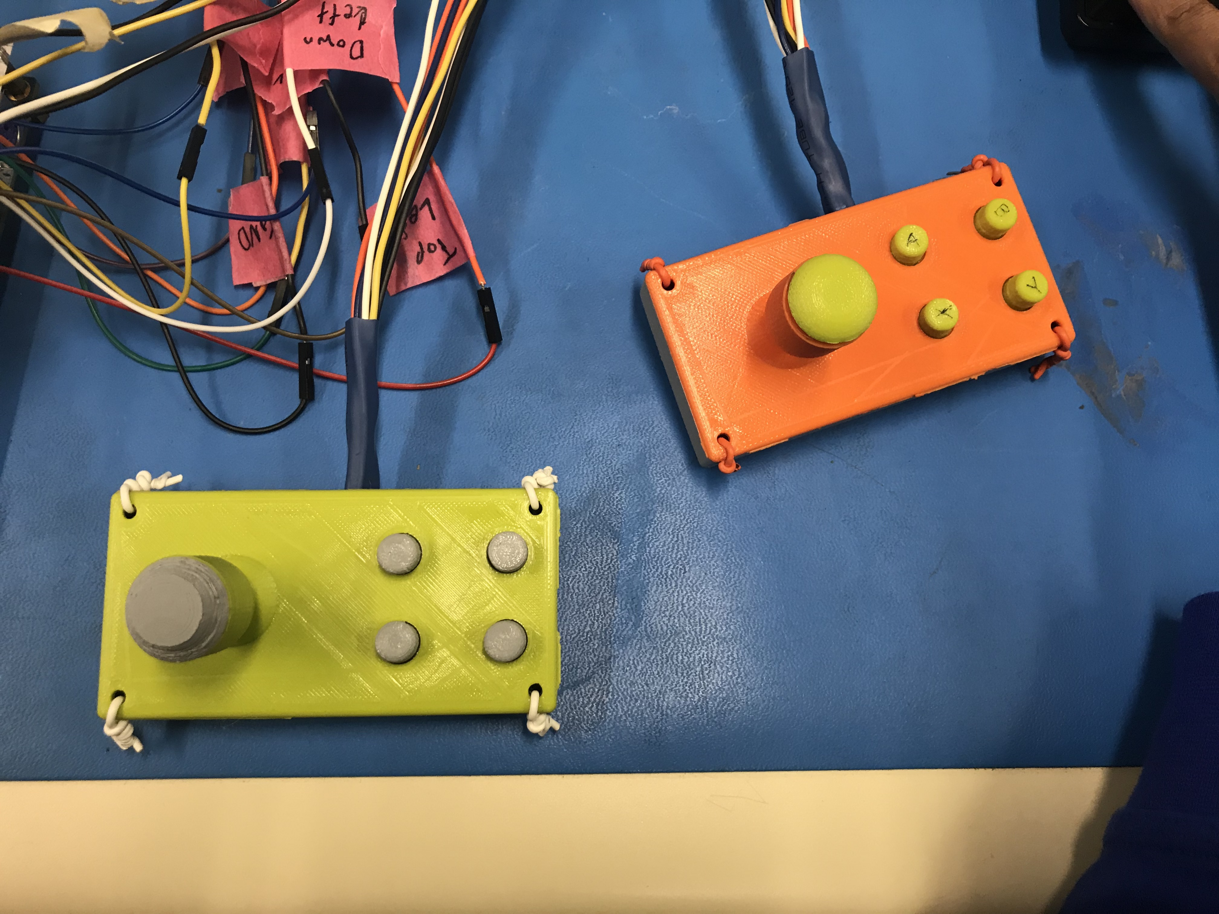
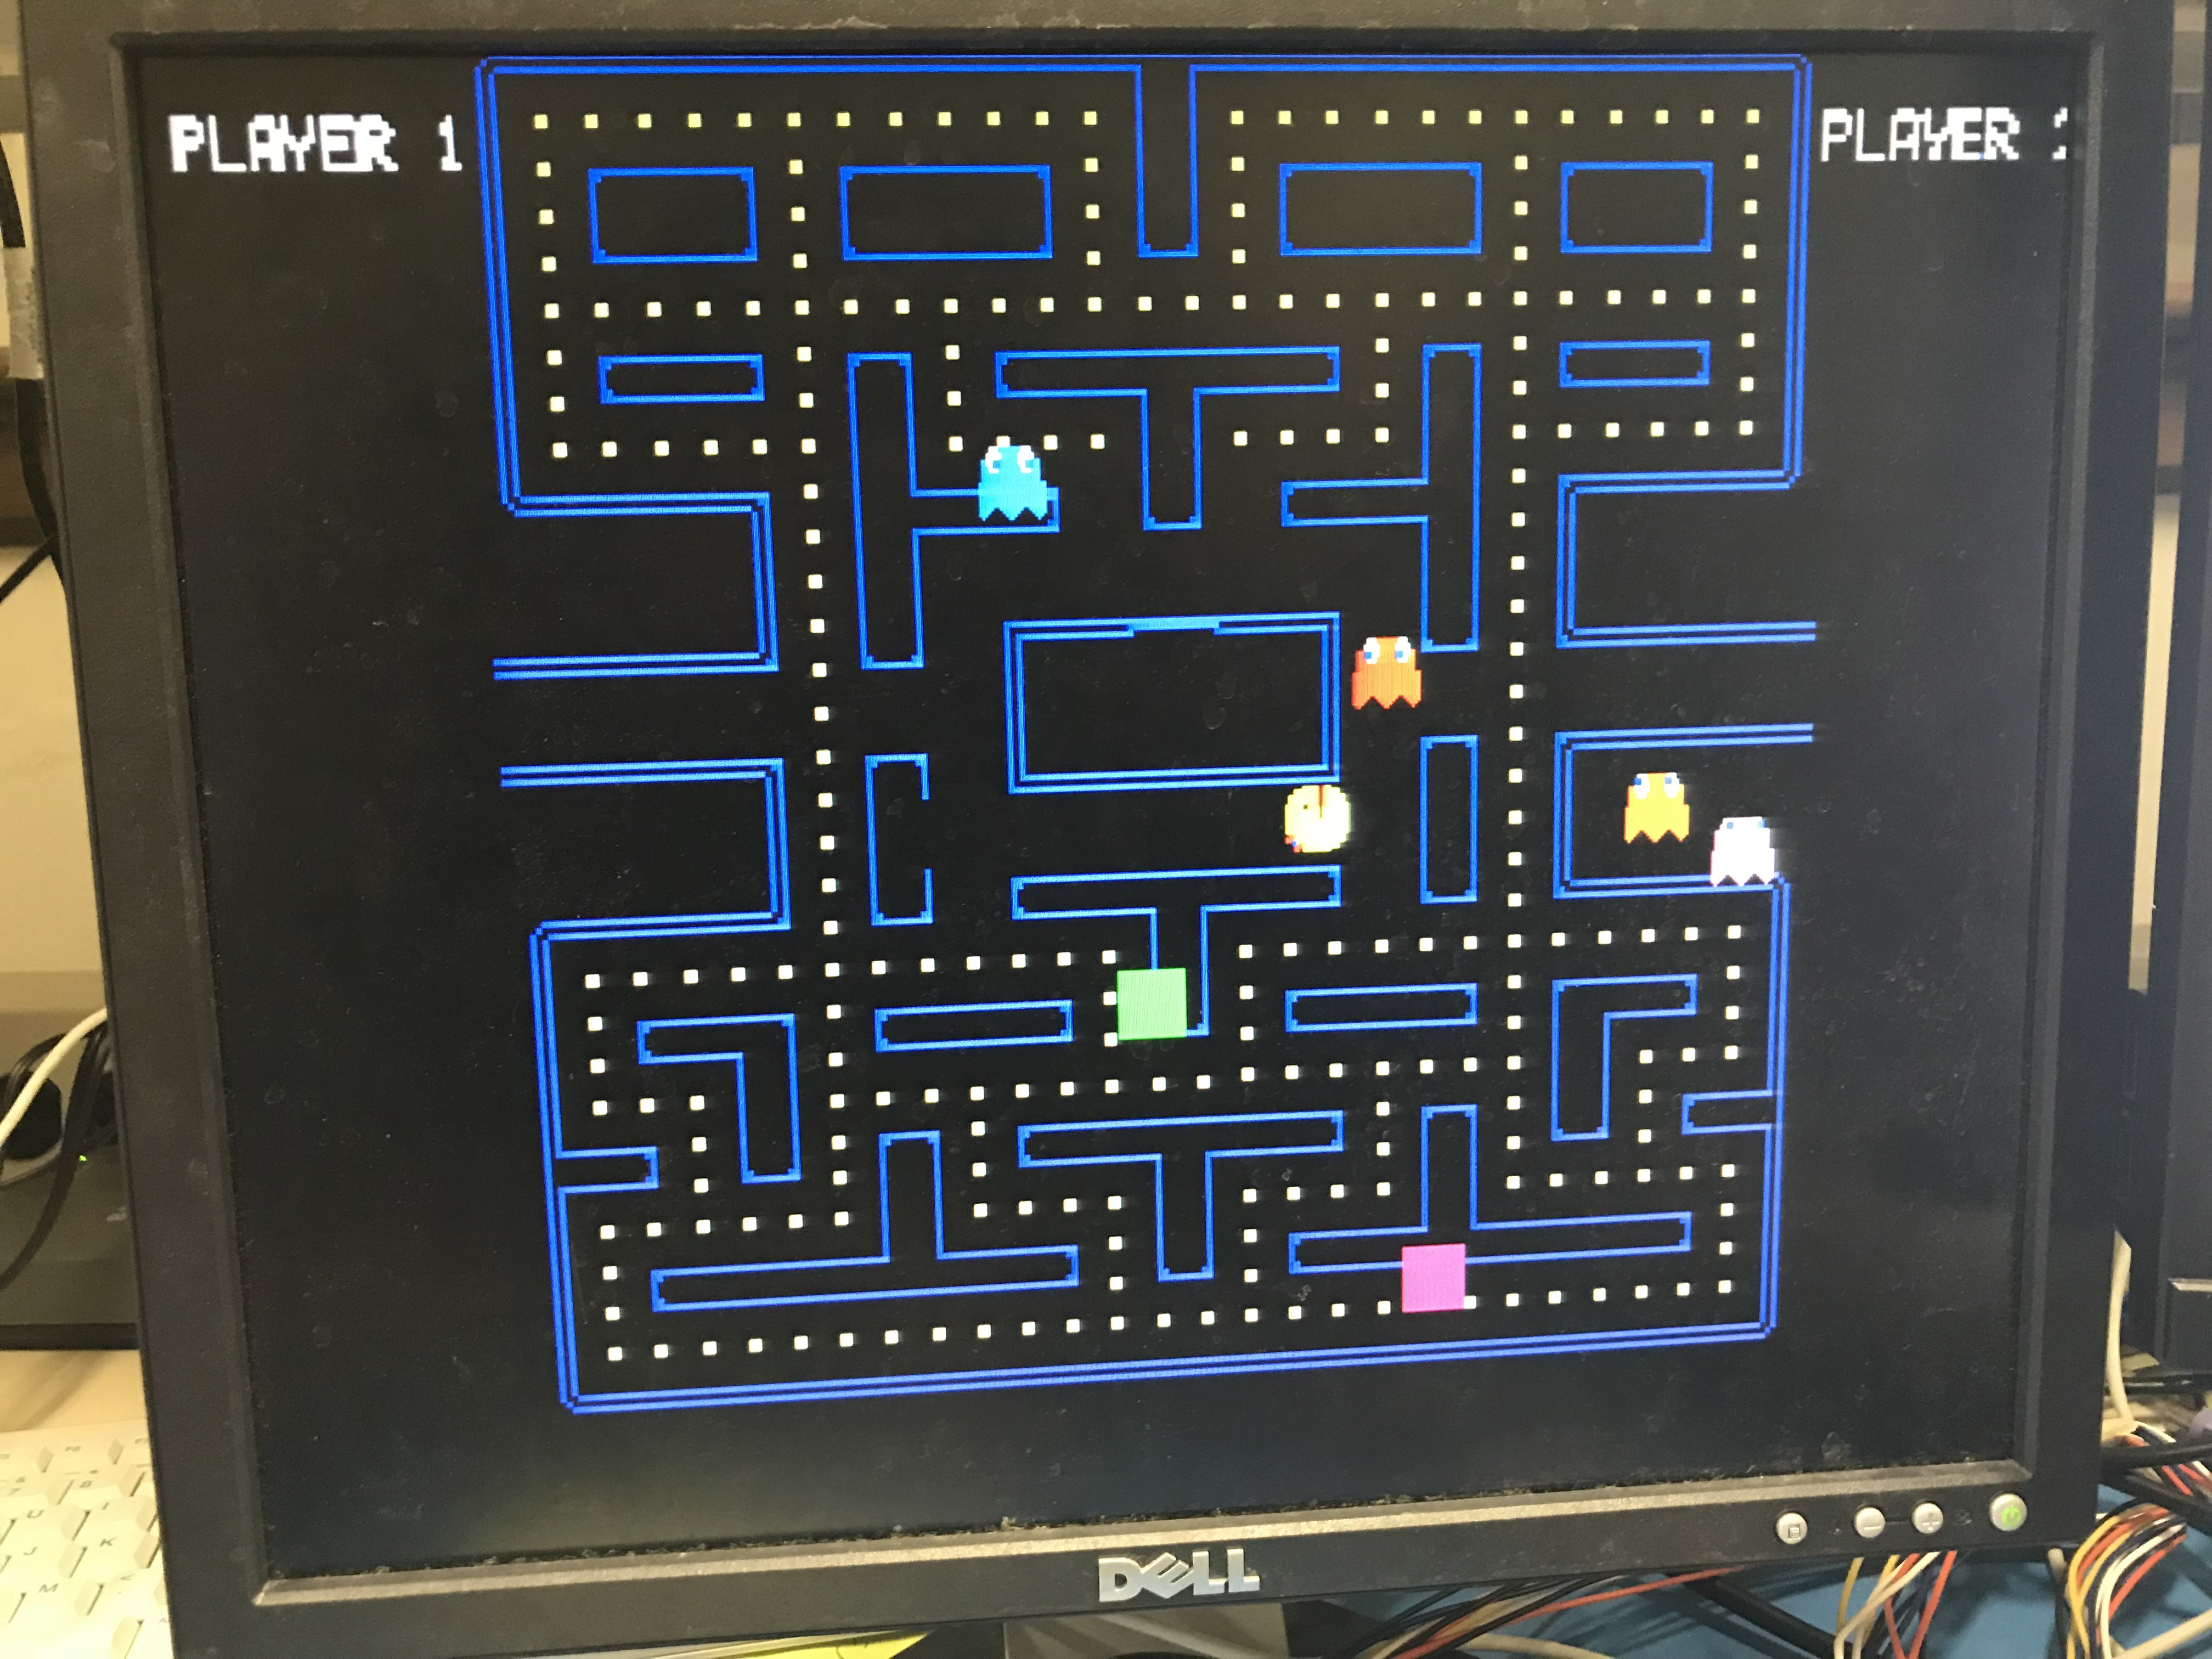
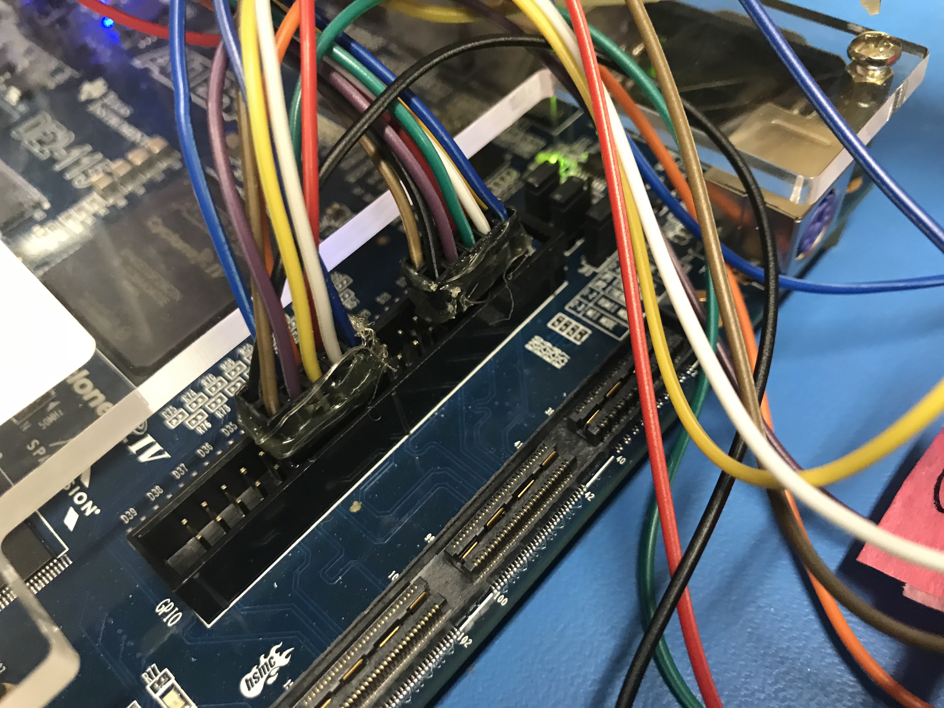
Input and Output

Slide 4
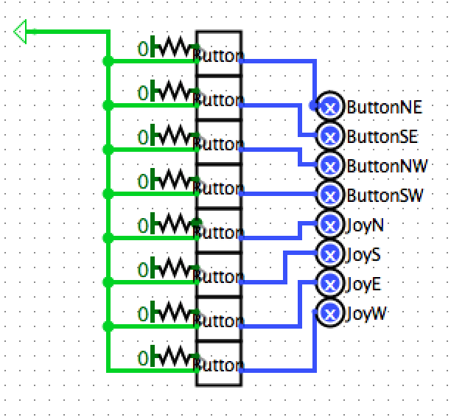
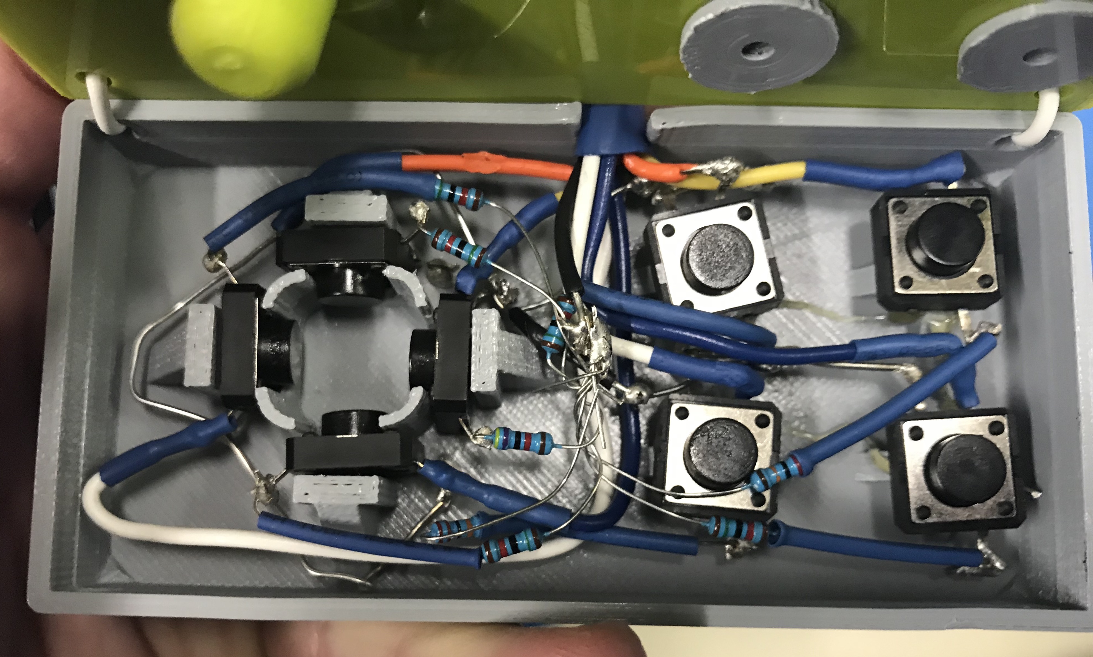
Controller Internals

Slide 5
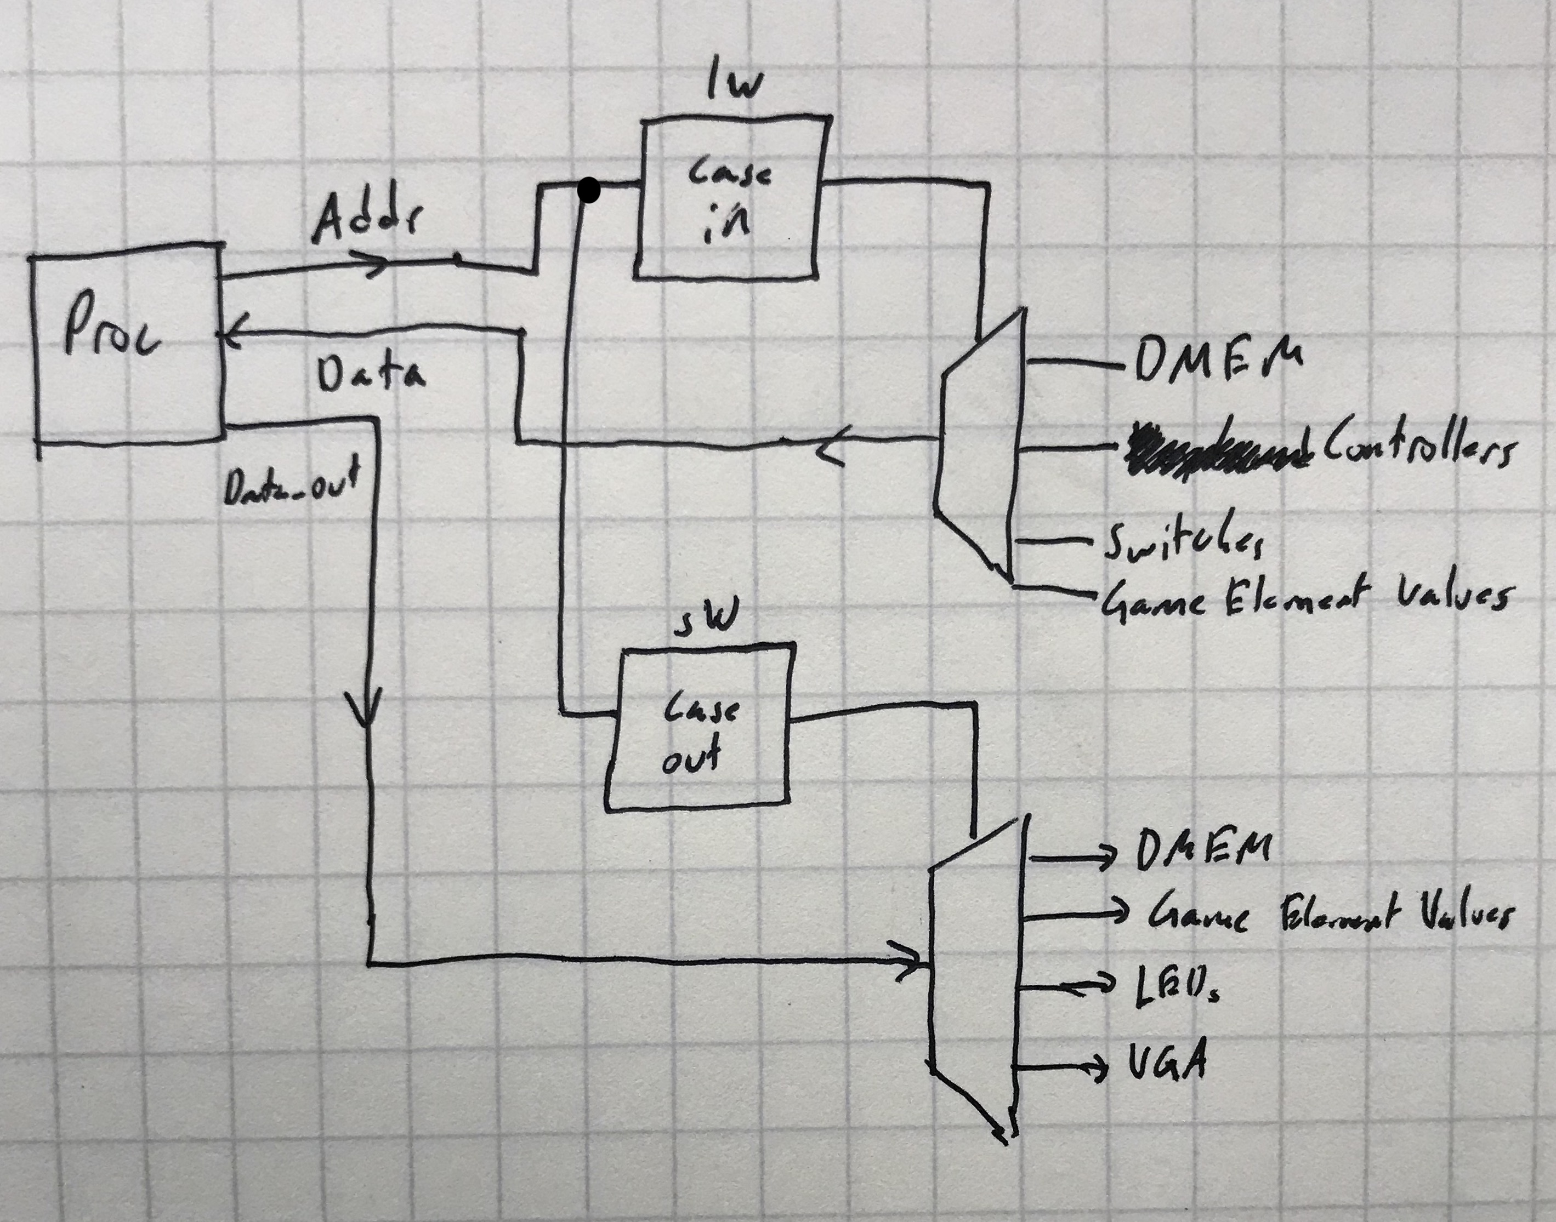
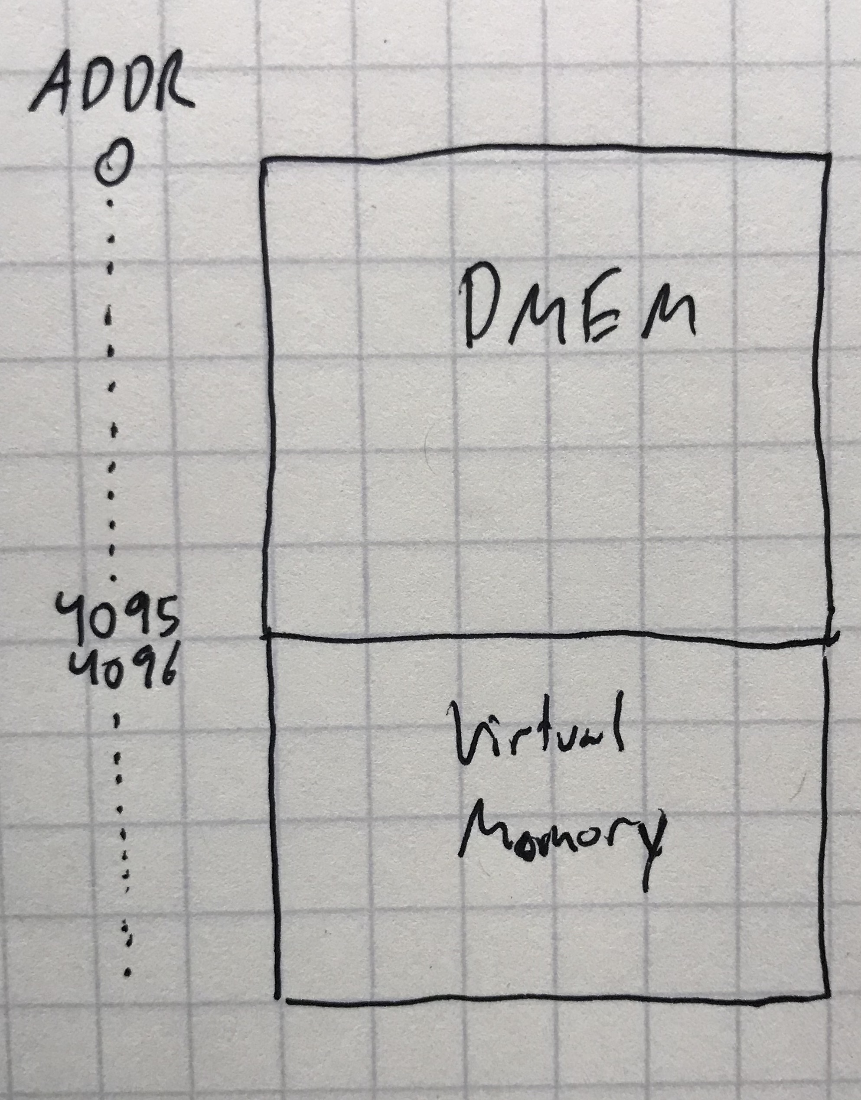
Processor Changes

Slide 6
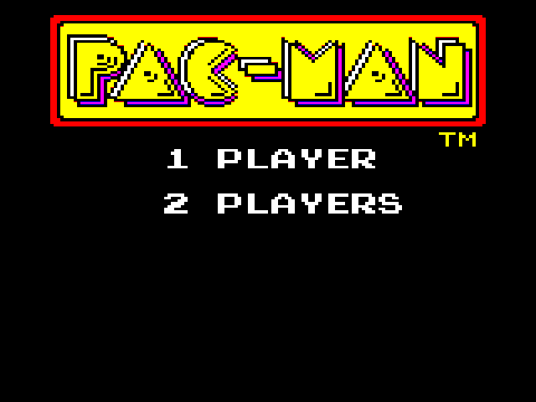
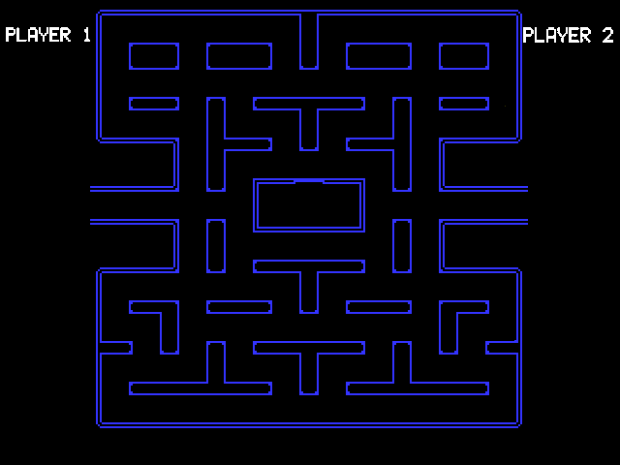


Main Screens

Slide 7
Special Features

Slide 8
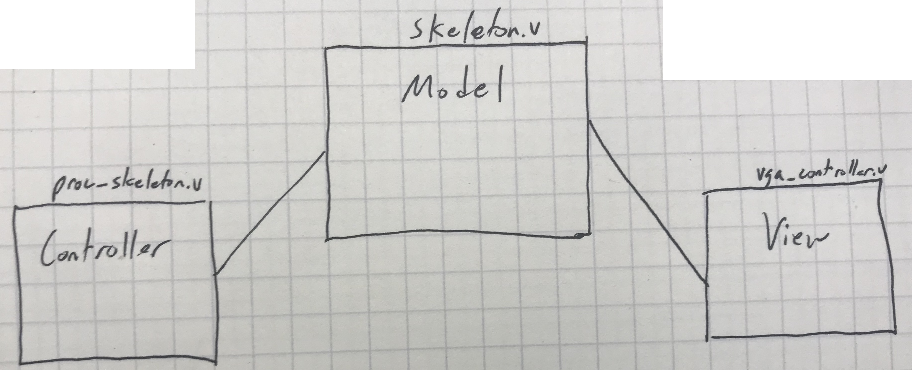
Project Design

Slide 9
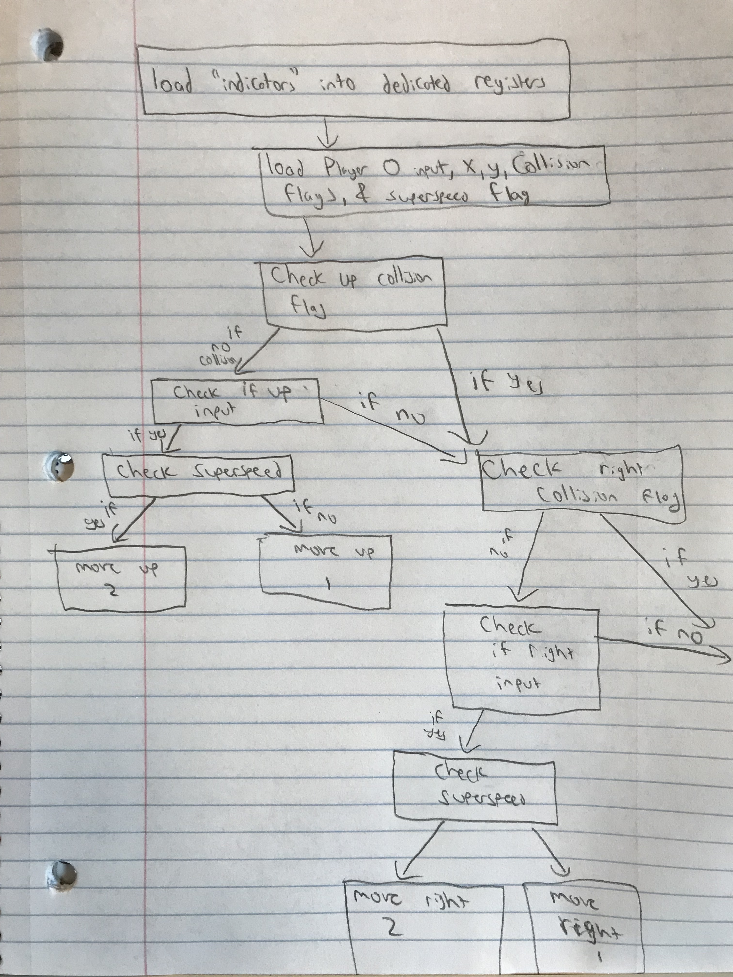
Assembly Code

